Slide 1
How do we know something is changing?
Notes:
Welcome! Names and intros. We are going to be visiting your class three times this spring to take about the work of the Stone Living Lab.
Icebreaker Do I mention science? Climate? Environment?

Slide 2
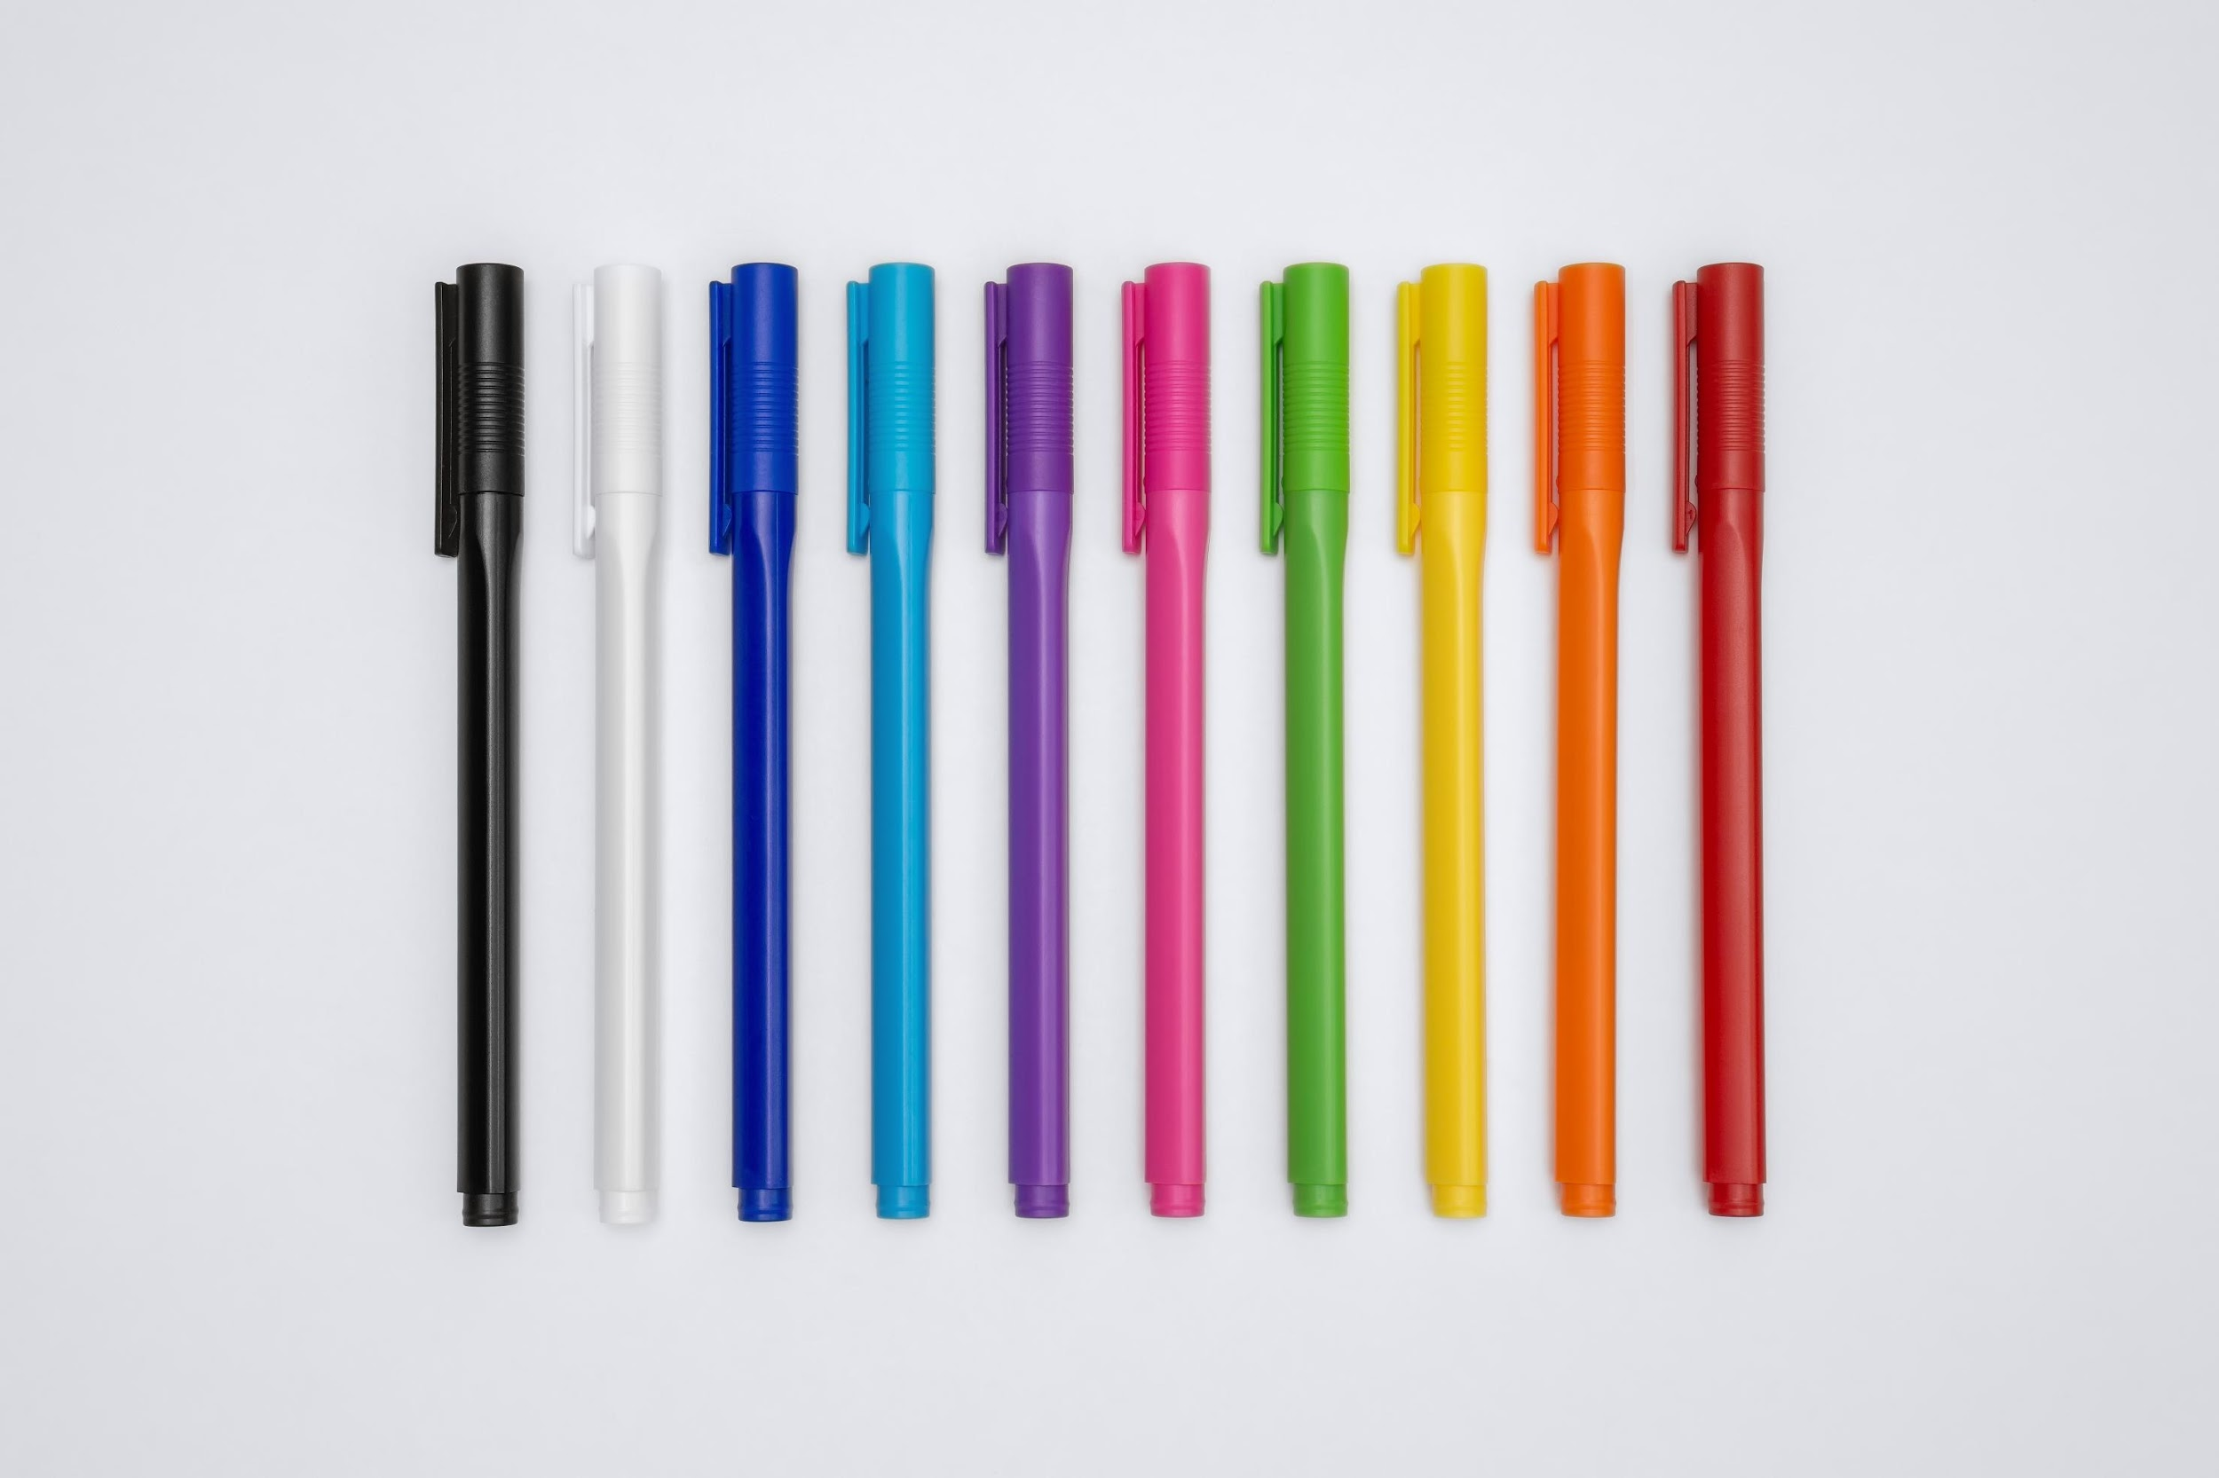
What do you think of when you hear the word laboratory?
Draw & share with your neighbor!
Notes:
First off, we are going to do some drawing! The Stone Living Lab is a laboratory. You each have some paper and pencils. For the next five minutes, please draw what you think of when you hear the word laboratory. After five minutes, turn to your neighbor and share your drawing. Talk about what you drew. What is similar between your drawings? What is different? We will then come back together and have a few volunteers share about what they and their partner drew.
Pair and share
5 minutes drawing
Ask a few students to share

Slide 3
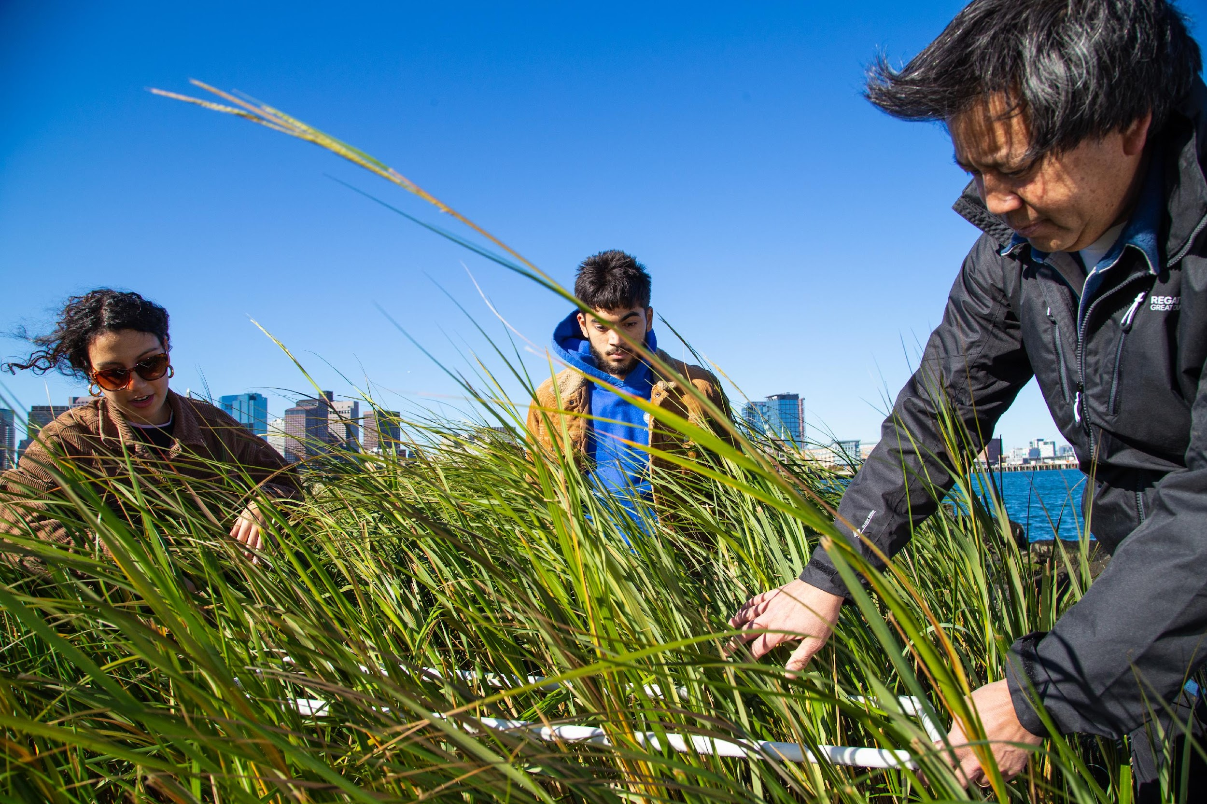
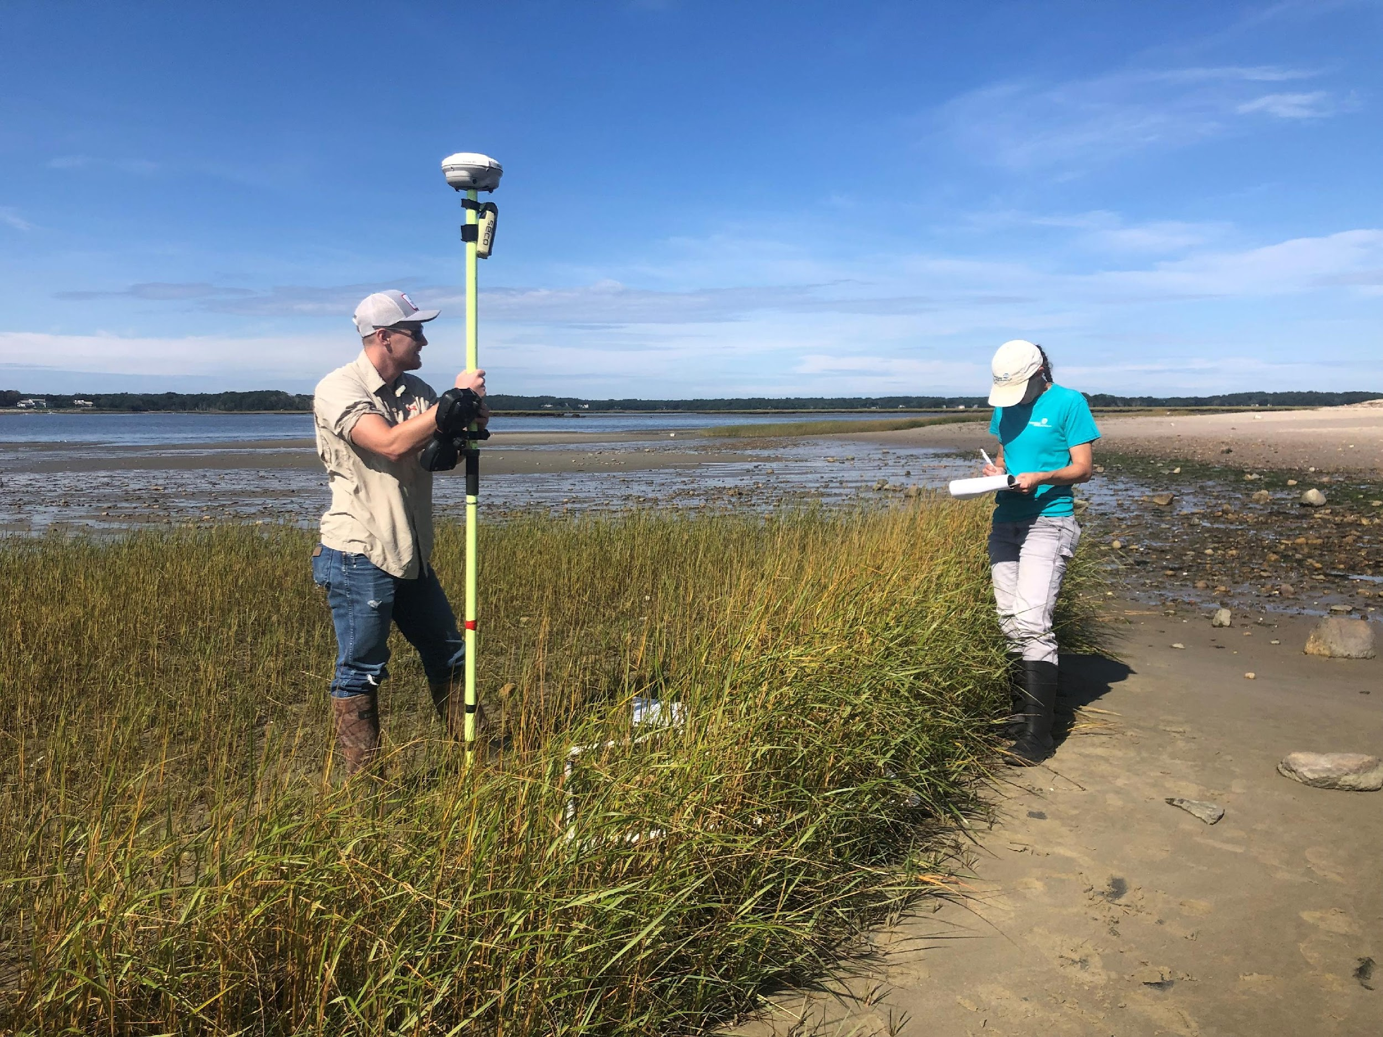
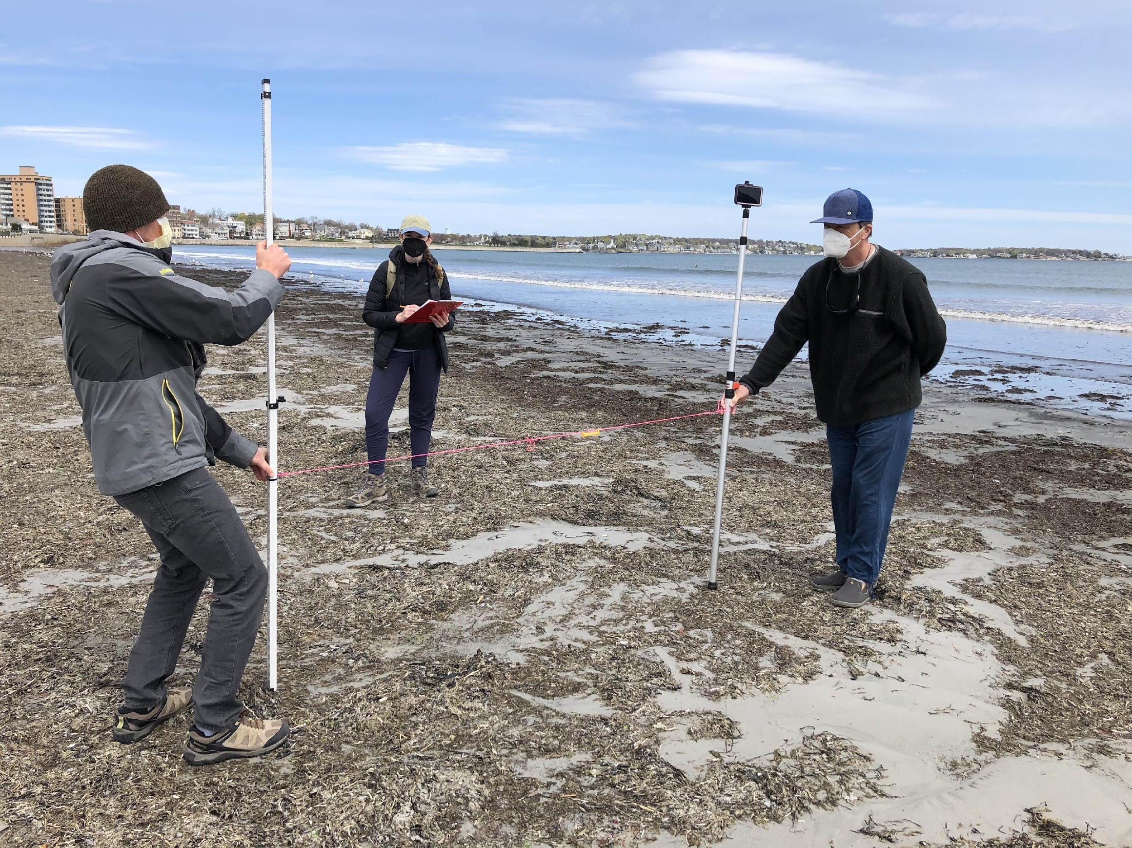
All of these people are scientists. What do you notice about where they're working?
Notes:
Look at these three pictures of scientists. Ask: were there any differences or similarities between what you drew and what you see? What do you notice about where they're working? All of these places are laboratories!

Slide 4
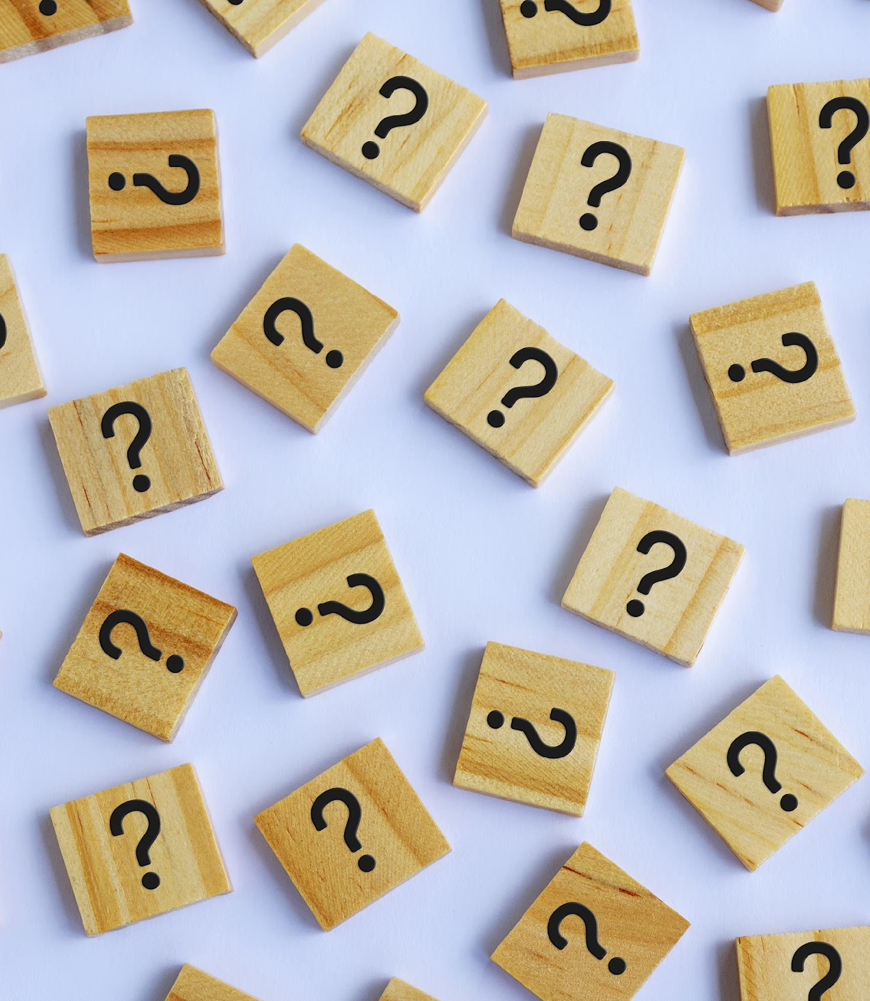
Laboratory: a place where you can ask questions, create theories, and test them out.
Notes:
This means that you can do science anywhere!

Slide 5
Notes:
Do you recognize what this map is showing?
This is Boston Harbor! We use this whole area as our Lab (blue circle). This is where you are right now – in our laboratory!
We ask questions about the coast, and about climate change. We know that climate change is going to affect Boston Harbor, and we want to figure out exactly how.

Slide 6
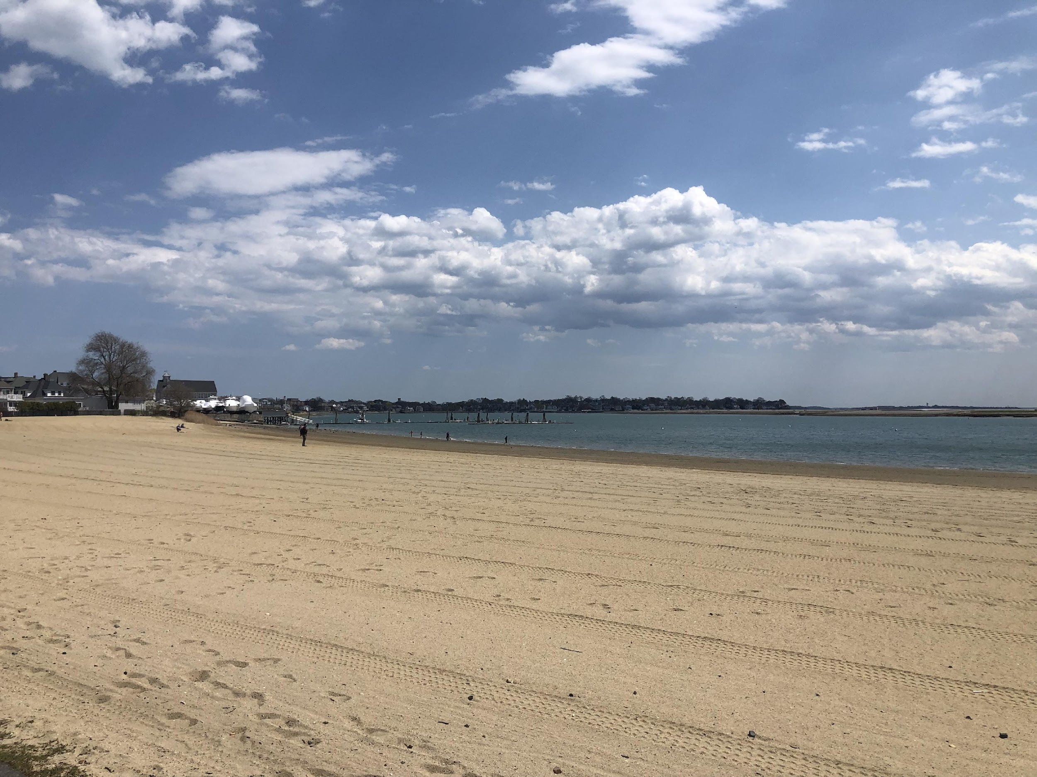
Does this place look familiar?
Notes:
This is one of the places we are interested in studying! Do you recognize it?
Answer: Constitution Beach
Ask: have you been to Constitution Beach?

Slide 7
